Slide 1
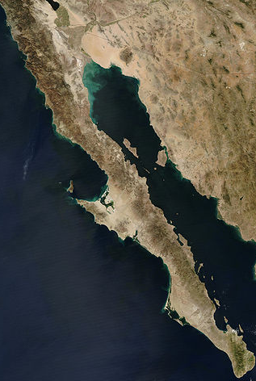
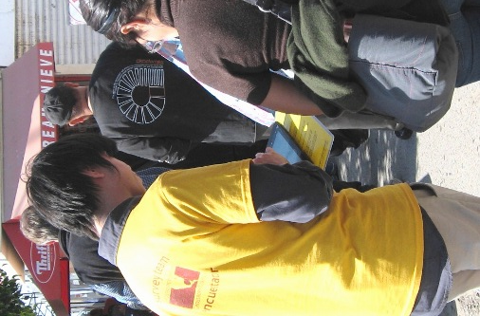
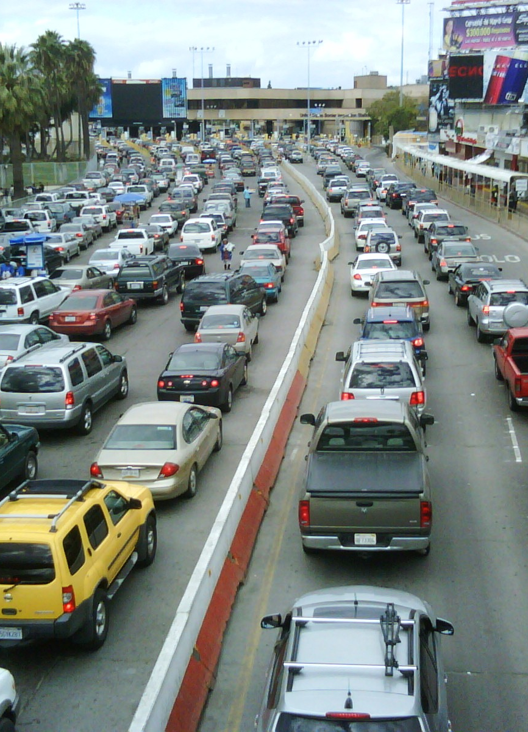
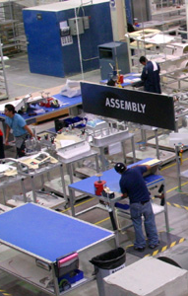
Mexico & the Border: Challenges and Tools for Business & Policy Research
Special Libraries Association Conference
South of the Border Panel • June 10, 2013

Slide 2
Ok…¿Quién Soy?

Slide 3
Introduction: Quien soy?
Kenn Morris
Founder & President/CEO of Crossborder Group Inc.
Gerente General de Crossborder NS, S de RL de CV
Nearly 20 years of business consulting, market research and policy research in Mexico, the US-Mexico border region
Directed “Crossborder Innovation & Competitiveness Initiative” at UCSD San Diego Dialogue
Appointed by US Secretary of Commerce as member of San Diego-Imperial County DEC

Slide 4
About Crossborder…
“Micro-Multinational” founded in 1996 in San Diego
Crossborder Group Inc. (1996, US)
Crossborder NS, S de RL de CV (2007, Mexico)
Key consulting & research staff in two offices:
San Diego, USA
Leader in US-Mexico market research and strategic consulting
Includes expertise & specialization in:
Industry & B2B research
Site selection analyses
Border policy research
Don’t typically do B2C or political research/surveys…
Tijuana, Mexico
Field & phone surveys in Mexico
Market-entry strategies
Crossborder retail

Slide 5
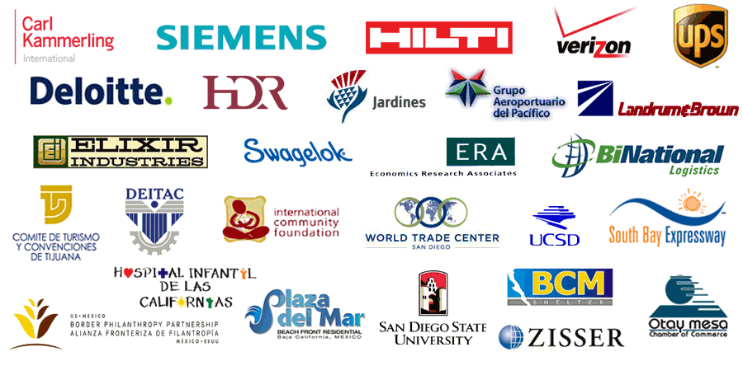
A few of crossborder’s clients

Slide 6
Approaching Market Research
in Mexico & at the Border

Slide 7
Research in Mexico: my standard approach…
In B2B & Policy research, not always clear, easy-to-find sources…
Data sets can be limited – if they exist at all.
Often have to resort to finding “proximate” secondary data…
…as well as create your own primary data in order to…

Slide 8
Research in Mexico: Approach as a “mosaic”
…have enough data to create a “mosaic” of market information

Slide 9
What Do I Mean?
A Few Examples of Questions
Crossborder’s Been Asked

Slide 10
“What’s the Economic Impact of Border Crossers (and what do they buy)?”

Slide 11
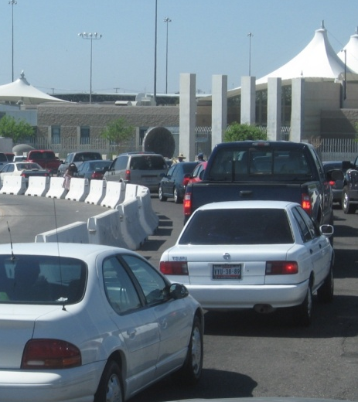
Border crossers – research Challenge
Understanding economic impacts or purchasing behavior of border crossers requires a few data elements:
Size of flow (northbound & southbound)
Quantity of expenditures (both sides)
Types of products/services/activities
Surprisingly little public data about 500K daily US/MX visitors…
Relatively good secondary data on volumes (cars, pedestrians, bus/train passengers…) from Customs & Border Protection & US Dept of Transport.
Infrequent and non-specific data about what they do…

Slide 12
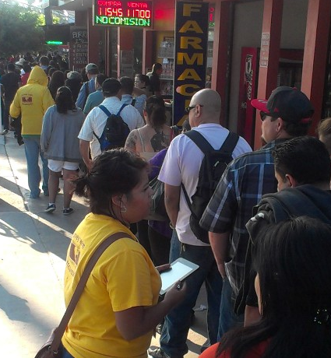
Border crossers – research approach
Like many border projects, have to pull together mosaic of secondary & primary data:
Secondary: regular requests to CBP officials for local data, use DOT’s Bureau of Transport Stats for borderwide info
No data from MX officials (could change)
Have built internal library (1996-2013)
Primary: to get the detail, needed to create own data – surveying border crossers…
Have applied nearly 20,000 at-border surveys since 2003
Many of those related to crossborder habits, tourism& shopping

Slide 13
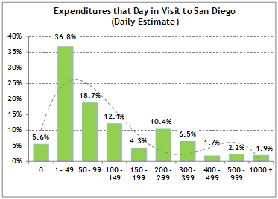
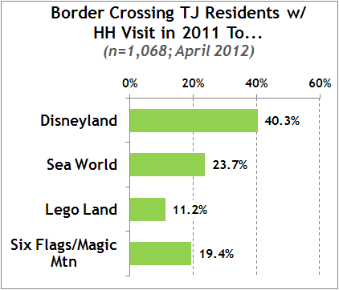
Border crossers – Research results
Border crossers are commuters, tourists, and consumers…
At-border surveys by Crossborder Group show typical $140-170 daily average expenditure by Mexico-residing border crossers
…$10-14 million in crossborder retail expenditures daily

Slide 14
“How Much Demand for Product X?”

Slide 15
Market estimations – research challenge
As in many countries, some data readily available…
import/export data (by HTS, from MX & US gov’t sources; some third-party marine trade data [PIERS, ImportGenius, Zepol, etc.])
Economic & business activity data (gov’t agencies, industry trade associations)
Some product-specific info – for well known products
The challenge: how to do market size estimates for new-to-market products or brand?
Can be common problem in Mexico
Markets may be very different from US – example: external building sheathing in a concrete building world…

Slide 16
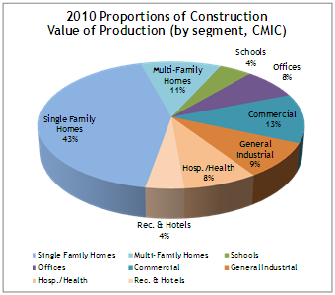
Market estimations - Research approach
Again, pulled together mix of secondary and primary data:
Secondary: building and construction industry data from housing agencies (INFONAVIT, CONAVI, INEGI, etc)
Secondary: industry associations (CMIC, CME [Consejo Mexicano de Edificación])
Secondary: import/export data
Still…found very little specific data
Primary: Directly-contacted real estate developers, contractors, and construction retailers
Over 40 phone interviews in major Mexico cities

Slide 17
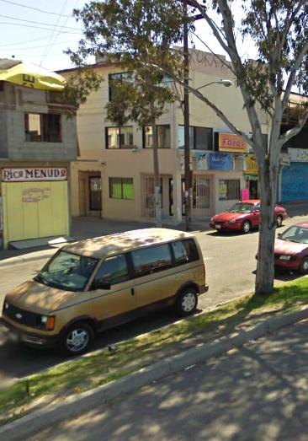
“Is this a Real Maquiladora Supplier?”

Slide 18
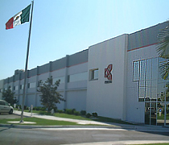
Company due diligence - Research challenge
Major Mexico-based manufacturer wanted to confirm ownership and legal status of suppliers
In US, this is pretty routine…
…not in Mexico
Much business intelligence is private – or difficult to access:
culture of tax avoidance
informal business practices
regionalism
lack of electronic databases
few comprehensive business data sources

Slide 19
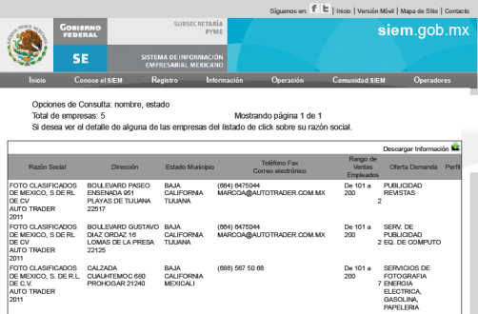
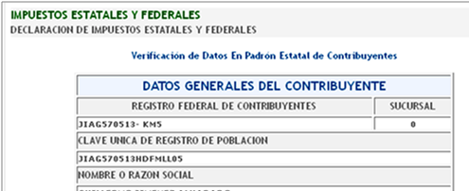
Company due diligence – research approach
Mosaic of secondary & primary data
Secondary research:
Registro Publico (public records… but often not avail for sole proprietorships)
SIEM (Sec. of Economia)
RFC (State Tax Registry)
Public contractor registries
City Treasurer office (biz licenses)
Sometimes: US records, as well…
Primary research:
Verification of address (site visit)
Contact company directly (“prospective client”)
Referrals to other companies

Slide 20
Some Takeaways…

Slide 21
likely use range of sources in biz & policy research
…to create “mosaic” of Mexico & border market information
News Reports
Industry Associations
Other Researchers
Gov’t Sources (Multi-, Fed, State & Local)
Primary Research
Quasi- Gov’t (utilities, biz promotion, econ dev)

Slide 22
Another key factor: ¿Todo en ingles?
Also important to consider:
Not all information will be available in English
Maybe 20-30% of possible secondary sources
So, as Dora says: “It’s important to be bilingual” (at least basic Español!)

Slide 23
Professional Tips:
A Few Tools for Researchers

Slide 24
Professional tips about Online Tools
Restating our Standard Assumption: Mexico & border data sought for projects may not be Googleable, may be tough to find, or may not exist
Admittedly, online sources are evolving…
1990s: UAG & San Diego libraries (old school: “card catalog”)
2013: Today, online Mexico data sources growing – but still not as prevalent as in US, Canada, or European markets
One reason: few traditional national or regional news sources – let alone policy makers – care about Mexico business or Border…
…at least beyond “narco” and/or “illegal immigration”
That said, here are a few sources that Crossborder regularly uses for business & policy information (not in order):

Slide 25
Online Tools (1): General & US news sources
…Google News Alerts (“Tijuana”, “Baja California”, “Economía (MX)”, “Mexico+Border”, “NAFTA”, “Maquiladora”, etc…)
…Twitter (@CBorderGroup follows 1,300+)
US/Global News Websites (w/ Border or Mexico focus):
UTSanDiego.com (border & business stories)
AZCentral.com (AZ Republic)
FronterasDesk.org (CA, AZ, NM & TX)
Bloomberg.com (LatAm Regional)
Reuters.com (World Markets/Mexico)
Less frequent but good: NYT.com, TheHill.com, WaPo…

Slide 26
Online Tools (2): Mexico news sources
Some Mexico-based News Websites (all Spanish):
TijuanaPress.com (Tijuana local/politics)
ZETATijuana.com (Tijuana local/politics)
TijuanaInformativo.info (Tijuana local/politics)
Siglo21.com.mx (Baja California industry)
ElFinanciero.com.mx (MX business/national)
ElUniversal.com.mx (MX national)
ADNPolitico.comm (MX national politics)
CNNExpansion.com (MX business/national)

Slide 27
Online Tools (3): Mexico demo & Industry information
Mexico Government Sites:
INEGI.org.mx (MX’s Census Bureau, Sp.)
Banxico.org.mx (Xrate, various econ data, Sp.)
Conapo.gob.mx (population projections, Sp.)
Conavi.gob.mx (housing data, Sp.)
SCT.gob.mx (transportation data, Sp.)
Datatur.sectur.gob.mx (tourism data, Sp.)
SIEM.gob.mx (Sec. of Economy, company data)
…We also submit IFAI requests to the above (FOIA)
Sample Industry Association Sites:
AMIA.com.mx (automotive industry, Sp.)
AMITI.org.mx (IT industry, Sp.)
CMIC.org (construction/housing data, Sp.)

Slide 28
¡Gracias! ¿Preguntas?
Kenn Morris, President/CEO of Crossborder Group
Email: Kenn @CrossborderBusiness.com
San Diego: 619-710-8120 • Tijuana: 664-380-6151

